Slide 1
Transformers for Suicidal Ideation Detection in Reddit Posts
Akshita Gandra
MIDS W266
Notes:
Hi everyone. I’m Akshita, and today I'll be discussing my work and paper on transformer-based models for detecting suicidal ideation in Reddit posts, with a specific focus on the performance of BERT, RoBERTa, and BERTweet architectures. This topic is personally interesting to me because I used to work in the medical field and mental health space and I studied Computational Cognitive Science, would love to work in the space again someday combining everything in my background

Slide 2
Motivation & Research Question
Suicide: global health crisis affecting 700,000+ annually
Reddit: anonymous platform for emotional disclosure
Research Question: Can transformers effectively detect indirect, metaphorical, or sarcastic expressions of suicidal ideation?
Beyond accuracy: interpretability, fairness, and clinical utility
Notes:
Suicide remains one of the top ten causes of death globally, but traditional detection methods are poorly equipped to identify nuanced expressions of distress, particularly on anonymous platforms like Reddit where users often communicate intent through coded language, metaphor, or sarcasm. I wanted to investigate whether transformer architectures could effectively detect subtle signals to help potentially augment behavior tracking by mental health professionals. I was also looking beyond raw accuracy metrics to explore interpretability constraints, fairness considerations, and real-world clinical utility. This matters because false negatives could miss life-threatening situations, while false positives could unnecessarily stigmatize users.

Slide 3
Dataset & Methodology
232,000+ posts from r/SuicideWatch, r/depression, r/teenagers (https://www.kaggle.com/datasets/nikhileswarkomati/suicide-watch/data)
Models trained:
  TF-IDF + Logistic Regression (baseline)
  BERT, RoBERTa, BERTweet
Balanced dataset: 50/50 suicide vs. non-suicide
Implementation: HuggingFace Transformers, PyTorch Trainer
Explainability: SHAP analysis, attention visualization
Notes:
The Kaggle dataset I found consisted of over 232,000 Reddit posts labeled based on their subreddit origin, which is a noisy but reasonable labeling approach that mimics real-world behavior. I maintained strict class balance throughout all experimental splits to ensure fair comparison. Beyond implementation with HuggingFace and PyTorch, I incorporated SHAP analysis and attention visualization to provide more insight into model decision-making. This dual approach was critical for understanding when and why models failed on edge cases like metaphorical expressions of distress.
Prior work on suicidal ideation detection has focused on applying traditional classifiers or fine-tuned BERT models to annotated Reddit or Twitter datasets (Ji et al., 2021; Qin & Lu, 2023). Some studies have used attention weights or SHAP to highlight influential words, but typically in settings with clean labels and explicit expressions of risk (Ashraf et al., 2023; Sharma & Chaturvedi, 2024). My work builds on this by testing transformer models under noisy, real-world subreddit-derived labels and analyzing how they behave when ideation is metaphorical, subtle, or ambiguous.

Slide 4
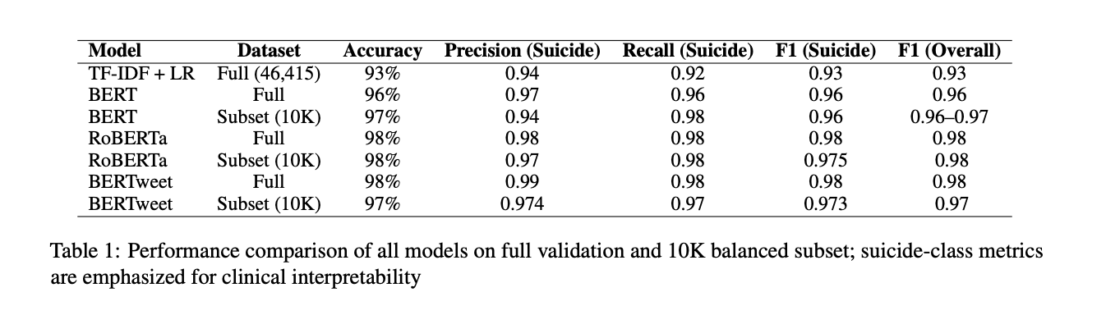
Results: Performance Metrics
Notes:
All transformer models outperformed the TF-IDF baseline, with RoBERTa and BERTweet demonstrating nearly identical macro performance at 98% F1. However, the nuances became clear when looking at class-specific metrics. RoBERTa achieved 0.992 recall on the suicide class, which would be critical for minimizing false negatives in high-stakes contexts, and BERTweet showed slightly better precision but also slightly lower recall. What's particularly interesting is that despite the noisy subreddit-based labeling strategy, these models achieved clinical-grade performance, suggesting transformers can effectively capture the semantic essence of distress expressions.

Slide 5
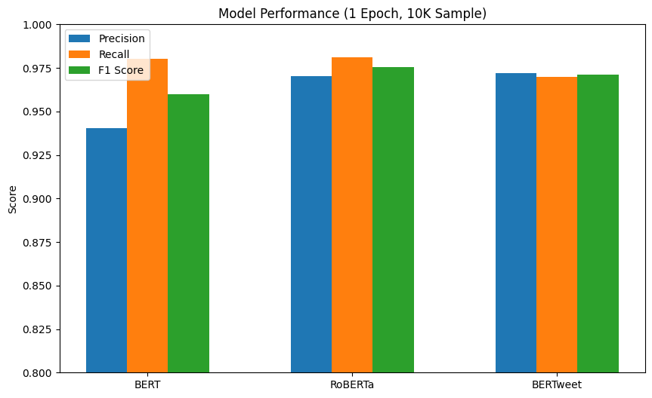
RoBERTa Outperforms Baselines
Notes:
This chart shows suicide-class performance for three models — BERT, RoBERTa, and BERTweet — evaluated on a balanced 10K subset after one epoch. I’m highlighting three metrics: precision, recall, and F1 score. RoBERTa stands out with the highest recall and F1 score, meaning it missed the fewest suicidal posts while maintaining strong overall accuracy.
BERT, on the left, shows a notable drop in precision — under 0.94 — and its F1 score also lags behind the others. This suggests it had more false positives and possibly relied on less contextual signals — likely due to its older, less optimized pretraining setup. BERT was trained on BookCorpus and Wikipedia, which don't reflect the tone, structure, or informality of Reddit.
BERTweet shows a balanced profile — strong precision and slightly lower recall than RoBERTa. Because BERTweet is pretrained on social media data, it’s particularly good at handling emojis, abbreviations, and informal phrasing. But it had slightly more variability in identifying emotionally complex posts. The takeaway here is that RoBERTa offers the best balance — especially under constrained training (1 epoch, noisy labels). Its dynamic masking and larger training corpus gave it an edge in generalization, particularly for veiled or indirect expressions of suicidal ideation.

Slide 6
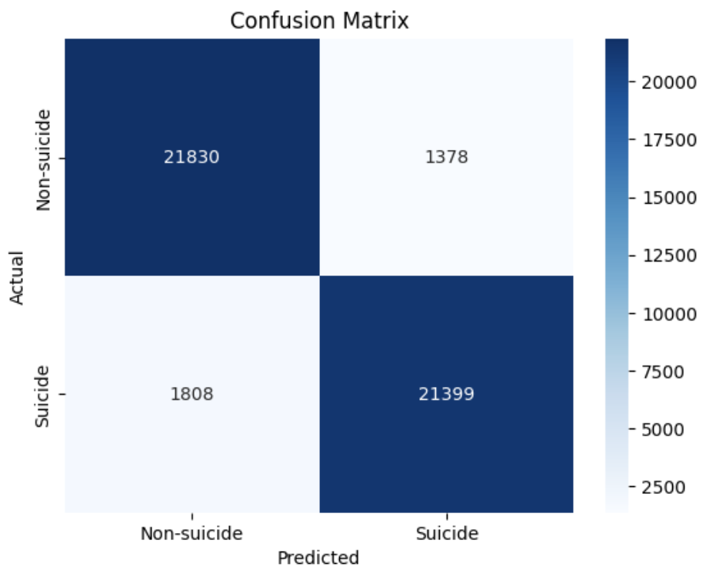
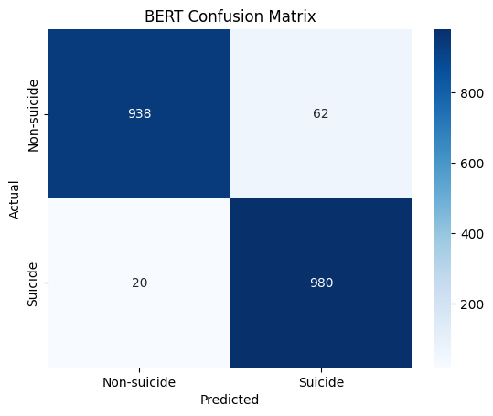
Confusion Matrix Analysis (1)
Notes:
These confusion matrices reveal distinct error patterns across architectures. The TF-IDF baseline shows symmetric error distribution—it missed about 6-8% of both classes. BERT showed a high false positive rate and slightly more false negatives, indicating it may rely more on surface-level cues.

Slide 7
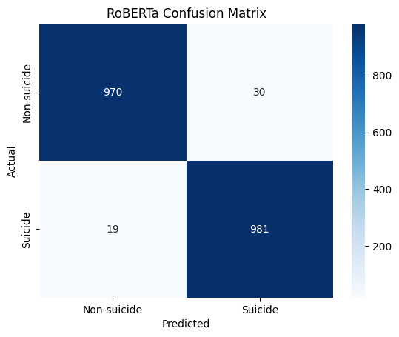
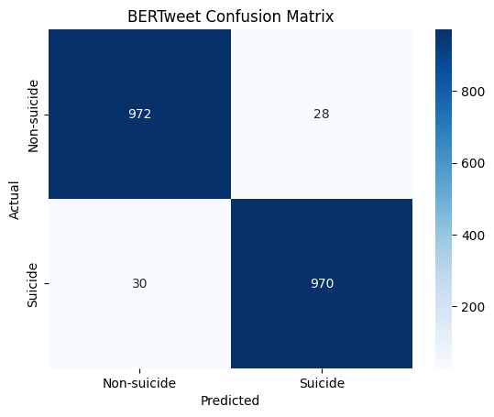
Confusion Matrix Analysis (2)
Notes:
In contrast, RoBERTa demonstrates asymmetric errors, with notably fewer false negatives in the suicide class. BERTweet exhibits balanced performance but struggles more with informally expressed distress. This asymmetry in error distribution is particularly significant for deployment considerations: RoBERTa would be preferred in contexts where missing suicidal ideation carries higher cost than false alarms.

Slide 8
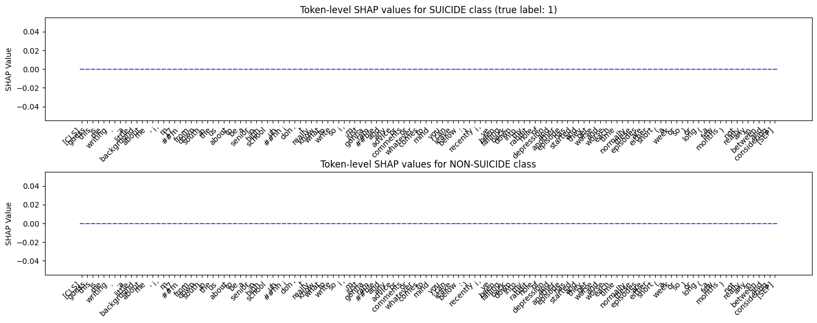
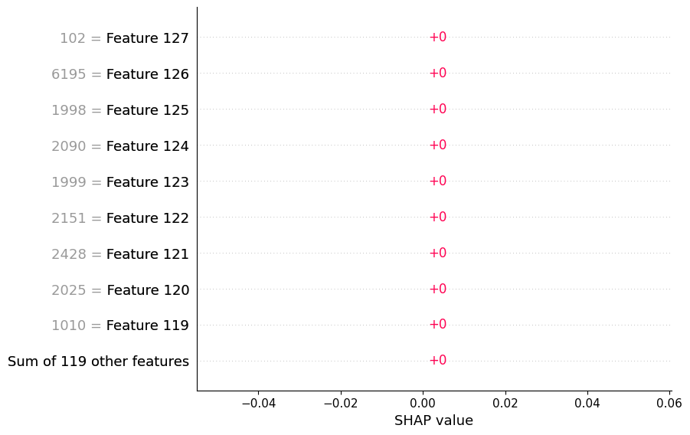
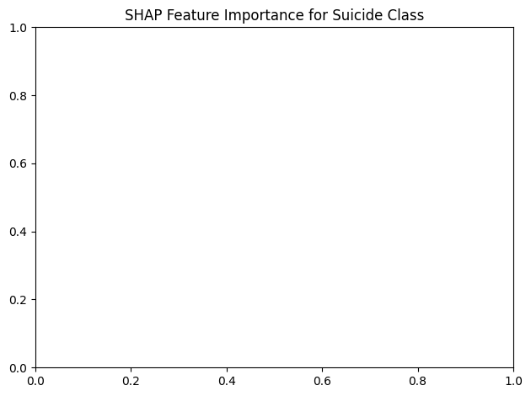
SHAP Analysis
Notes:
When applying SHAP analysis to examine which tokens influenced model decisions, I made a surprising discovery. In high-confidence predictions, SHAP values were essentially zero across all tokens - meaning the model wasn't making decisions based on specific keywords. Even in uncertain cases with probabilities around 50-70%, I couldn't attribute decisions to individual words. This reveals that transformers are using complex patterns across the entire text rather than isolated features. This creates a practical challenge for clinical settings where doctors and moderators need to understand why a post was flagged as concerning.

Slide 9
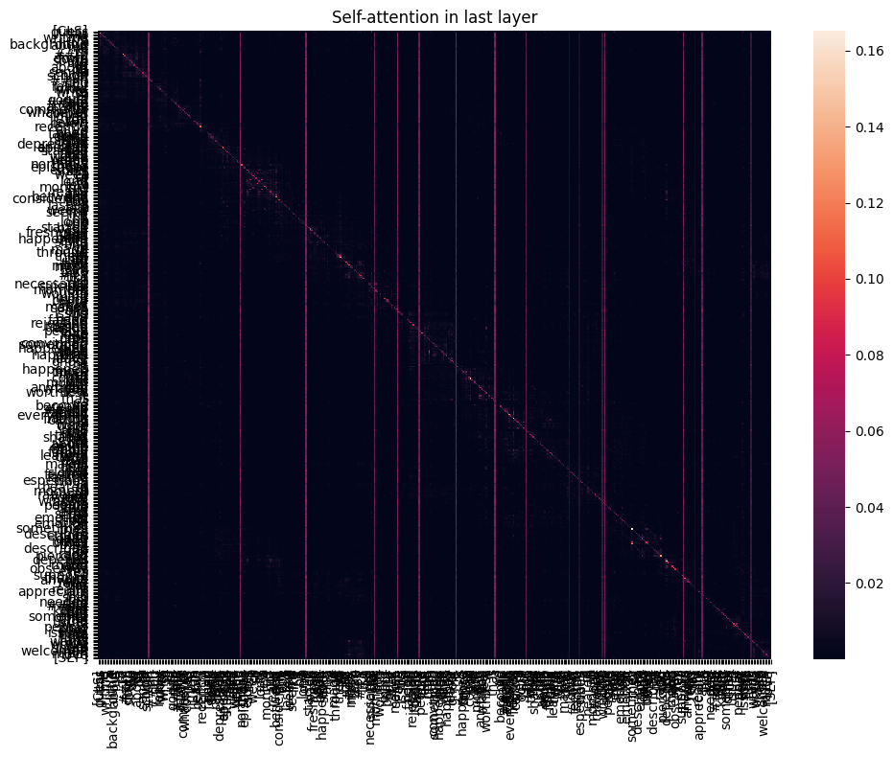
Attention Patterns &
Global Features
Notes:
To complement SHAP's limitations, I visualized the self-attention matrix from BERT's final transformer layer. The diagonal dominance indicates strong self-attention, but the off-diagonal patterns reveal meaningful cross-token relationships. These horizontal and vertical bands with higher intensity suggest that certain tokens, likely emotional markers and connective phrases, influence multiple others. This supports the hypothesis that BERT is modeling inputs holistically and extracting meaning from relational patterns rather than specific keywords, which is a desirable feature.

Slide 10
Misclassification
False Positives: General distress without suicidal intent
False Negatives: Metaphorical expressions and subtle deterioration
Implications: Error patterns reveal model limitations
Model Differences: RoBERTa more resistant to false negatives
Notes:
My error analysis revealed distinct patterns in model mistakes. False positives typically occurred with posts containing general emotional distress or third-person discussions about suicide - the models overweighted emotional language without recognizing the lack of personal intent. False negatives happened most often with metaphorical expressions or posts describing gradual deterioration without explicit suicidal keywords. These used coded language that models struggled to identify.
RoBERTa had significantly fewer false negatives than other models, making it more suitable for scenarios where missing a suicidal post is costlier than false alarms.

Slide 11
Key Takeaways
RoBERTa consistently outperforms other models for suicide detection, especially in minimizing false negatives (critical for real-world deployment)
Transformer models achieve near-clinical reliability (98% F1) despite noisy labeling; ethical deployment requires balancing accuracy with interpretability and fairness
SHAP analysis reveals limitations in token-level interpretability for transformer models
Global attention patterns suggest models rely on distributed representations rather than isolated keywords
Notes:
The key takeaways are
RoBERTa achieves highest recall for suicide detection (critical for real-world use)
Transformer models use distributed representations rather than keywords
RoBERTa outperforms other models because of dynamic masking and a larger training corpus which gives it an edge. It is better at capturing subtle emotional signals despite minimal fine-tuning.

Slide 12
Ethical Limitations
Bias & Fairness: Demographic disparities in model performance
Interpretability: Gap between clinical needs and model transparency
Real-time & Longitudinal: Content drift and evolving expressions
Deployment Constraints: Integration with human moderation
Notes:
My approach raises several ethical concerns. First, the labeling method (using subreddit origin as a proxy for suicidal content) may inadvertently encode demographic or linguistic biases. This could disproportionately affect specific user groups, particularly younger users or minority populations who express distress differently. Second, the 'black box' nature of these models conflicts with clinical requirements for transparent decision-making. When interventions might be life-critical, this lack of explainability becomes problematic. Additionally, suicidal language evolves rapidly, especially among teens, requiring continuous model updates. These limitations suggest these systems should augment rather than replace human judgment.

Slide 13
Future Directions
Multilingual & Cross-Cultural Adaptation
Temporal & Behavioral Modeling
Hybrid Interpretability with Prompt-Based Models
Human-in-the-Loop Systems
Notes:
While transformer models demonstrate strong performance, several promising research directions could address current limitations. Cross-lingual transfer learning could allow detection across non-English communities. Temporal modeling could capture risk progression over time. Hybrid approaches blending RoBERTa with prompt-based models might balance performance and interpretability. And most importantly, human-in-the-loop systems could leverage clinician feedback for continuous improvement while maintaining ethical safeguards.

Slide 14
Conclusion
RoBERTa & BERTweet: Superior performance for detecting subtle expressions
Interpretability Gap: Critical challenge for clinical trust
Beyond Classification: Need for explainable, fair, and longitudinally stable systems
Notes:
To conclude, transformer models—particularly RoBERTa and BERTweet—demonstrated exceptional performance in detecting subtle expressions of suicidal ideation, outperforming classical approaches and achieving near-clinical reliability despite noisy labeling. However, the interpretability gap I've identified represents a significant challenge for deployment in high-stakes settings. My findings suggest that while transformers offer powerful tools for mental health monitoring, their implementation requires careful consideration of explainability, fairness, and temporal stability. The next frontier lies not in improved accuracy, but in developing systems that maintain performance while offering transparent, actionable insights to clinicians.

Slide 15
Thank You!

